Slide 1

Quantum Computing and Intelligent Computing Integration

Slide 2

目录
CONTENTS
01
Introduction to Quantum Computing
02
Introduction to Intelligent Computing
03
Case Studies and Applications
04
Challenges and Future Directions
05
Conclusion

Slide 3


01
Introduction to Quantum Computing

Slide 4

Basic Principles of Quantum Computing
Quantum Bits and Superposition
Quantum bits, or qubits, can exist in superposition states, allowing quantum computers to process vast amounts of data simultaneously. This enables parallel processing capabilities far beyond classical computers. For example, a system with just 300 qubits can represent more states than there are atoms in the observable universe.
Quantum Entanglement and Its Applications
Quantum entanglement allows qubits to be interconnected regardless of distance, enabling instantaneous communication and correlation. This property is crucial for quantum computing and is used in applications like quantum cryptography to create secure communication channels.
Quantum Gates and Circuits
Quantum gates are the building blocks of quantum circuits, manipulating qubits through specific operations. These gates enable the implementation of complex quantum algorithms, such as the quantum Fourier transform, which achieves exponential speedup over classical algorithms.

Slide 5
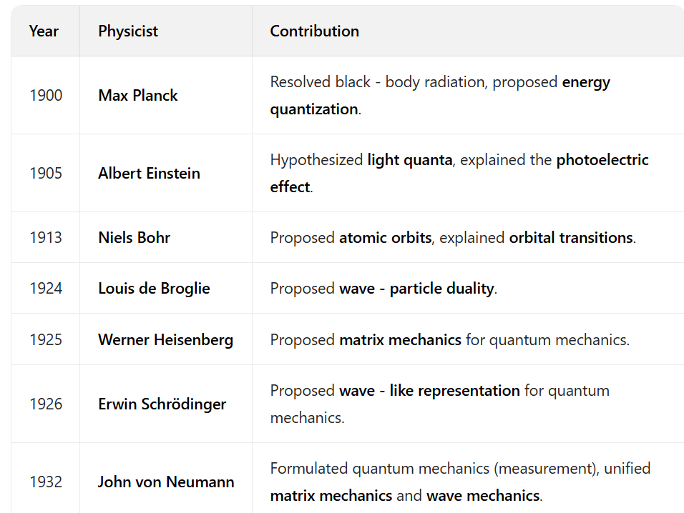
Timeline of Quantum Mechanics Milestones

Slide 6
Qubit
Superposition
A qubit is the basic information unit of a quantum computer. Unlike a bit in classical computing, it can simultaneously exist in a superposition state of both 0 and 1.
2.Wavefunction and Measurement
The state of a qubit is described by a wavefunction. Its specific state can be determined through measurement.
3.Coherence
Qubits exhibit coherence—they can maintain their superposition state for a relatively long time and are less prone to external interference.
4.Entanglement
Qubits exhibit entanglement—a special correlation can exist between two or more qubits, making their states mutually dependent.

Slide 7
Quantum Superposition and Quantum Entanglement
Quantum Superposition
A qubit can simultaneously exist in a superposition state of both 0 and 1. This state is called quantum superposition.
2.Quantum Entanglement in Quantum Computing
Quantum entanglement is one of the key properties in quantum computing. It enables parallel computation, thereby increasing the computational speed of quantum computers.
3.Definition of Quantum Entanglement
A special correlation can exist between two or more qubits, making their states mutually dependent. This state is called quantum entanglement.
4.Quantum Entanglement in Quantum Communication
Quantum entanglement is also a crucial property in quantum communication. It enables the secure transmission of information.

Slide 8
Quantum Gates and Quantum Algorithms
Quantum Gates
Quantum gates are the basic operations in quantum computing, analogous to logic gates in classical computers. They can act on qubits and alter their states.
Quantum Algorithms
Quantum algorithms are computational methods leveraging the principles of quantum mechanics. They can solve problems that classical computers struggle to tackle. For example:
Shor’s Algorithm: Rapidly factors prime numbers.
Grover’s Algorithm: Accelerates searches in unstructured databases

Slide 9
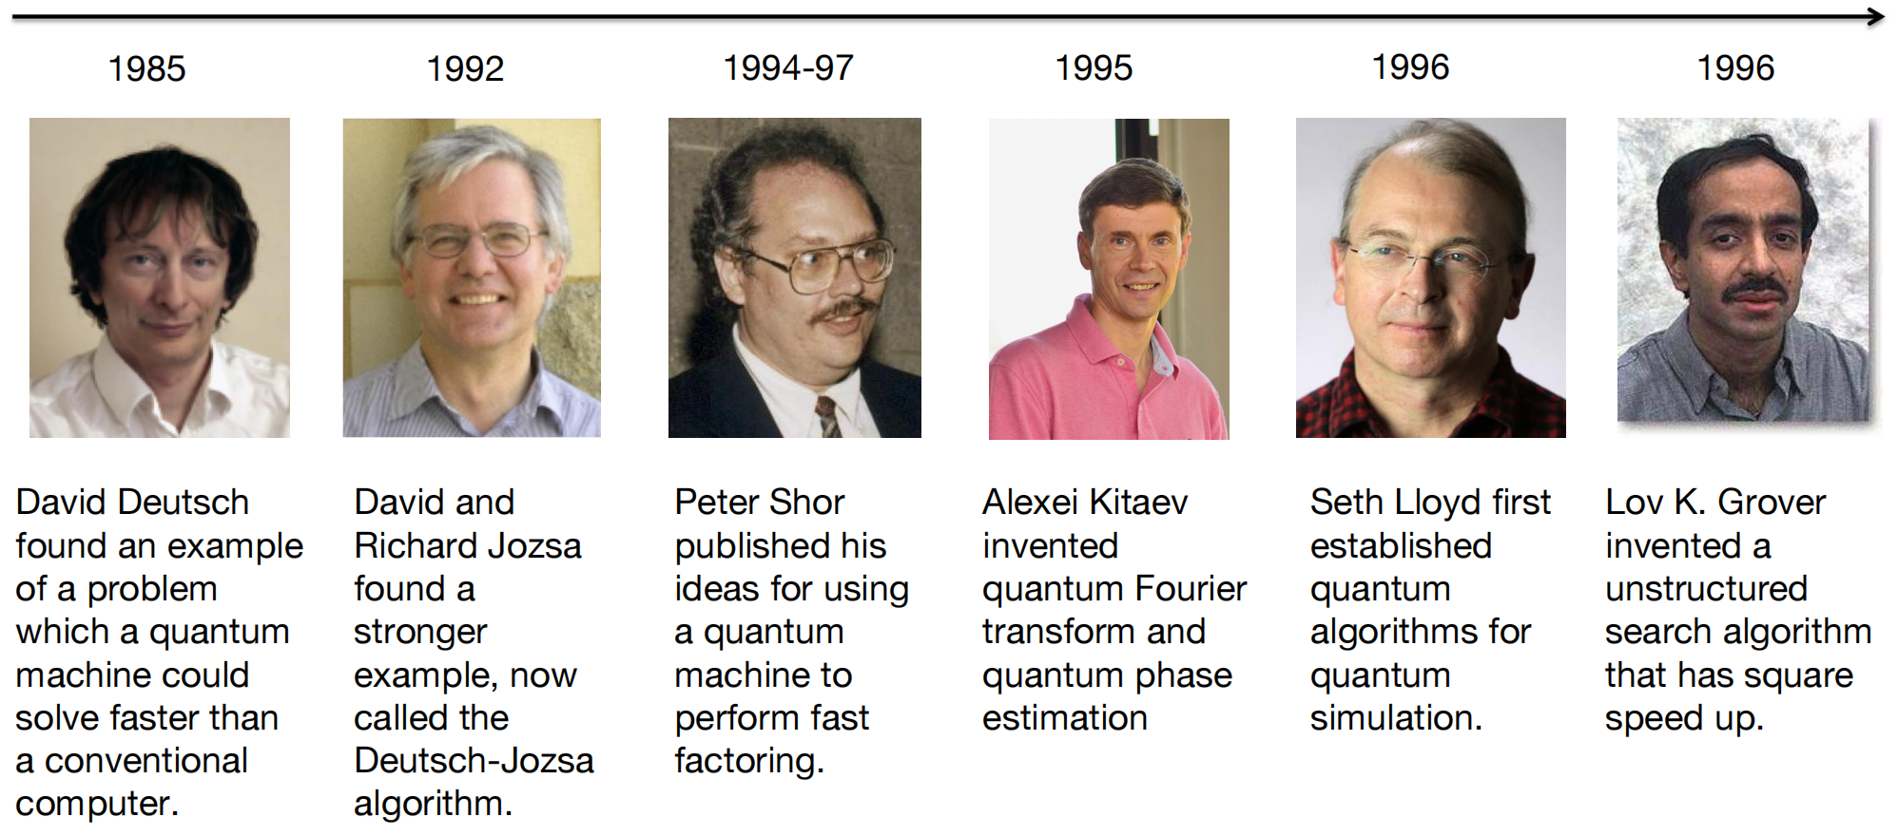
The Development of Quantum Algorithms

Slide 10
Quantum Error Correction and Fault Tolerance
Quantum Error Correction
Since qubits are susceptible to external interference and thus lose coherence, quantum error correction is needed to ensure the correctness of computations. Quantum error - correcting codes can combine multiple physical qubits to form a logical qubit, thereby extending its coherence time.
Quantum Fault Tolerance
The introduction of quantum error - correcting codes increases computational complexity. Therefore, quantum fault tolerance is required to reduce this complexity. Quantum fault tolerance employs specialized quantum algorithms and quantum gates to enable fault - tolerant computing, thus lowering the hardware requirements.

Slide 11
Bomparison Between Classical Computing and Quantum Computing
Characteristics | Classical Computing | Quantum Computing
Basic Unit | Bit: 0 or 1 | Qubit (Quantum Bit): Can be in a superposition state of 0 and 1 simultaneously
Information Representation Capability | n bits can represent 1 out of 2^n states | n qubits can represent all 2^n states simultaneously
Parallel Processing | Limited, requiring multiple operations | Naturally parallel, capable of processing multiple states in a single operation
Computational Complexity | Certain problems require exponential time | Can achieve exponential acceleration on certain specific problems
Stability | Highly stable | Easily affected by the environment, with significant decoherence issues
Technology Maturity | Very mature | Still in the early development stage

Slide 12

Quantum Computing Hardware
01
02
03
Types of Quantum Computers
Challenges in Quantum Hardware Development
Current State of Quantum Hardware
There are several types of quantum computers, including superconducting quantum computers, ion trap quantum computers, and photonic quantum computers. Each type has its own advantages and challenges, with ongoing research aimed at improving their performance and reliability.
Developing quantum hardware faces challenges such as maintaining qubit coherence, scaling up the number of qubits, and minimizing error rates. Researchers are working on innovative materials and error correction techniques to overcome these hurdles.
Major tech companies and research institutions are making progress in developing quantum processors with increasing numbers of qubits and improved coherence times. The focus is now on improving the fidelity of quantum operations and developing fault-tolerant quantum computers.

Slide 13
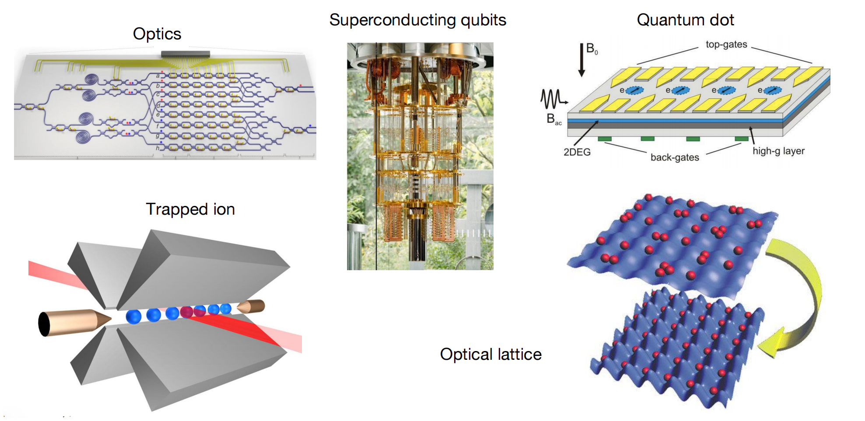
Quantum Hardware Implementation

Slide 14
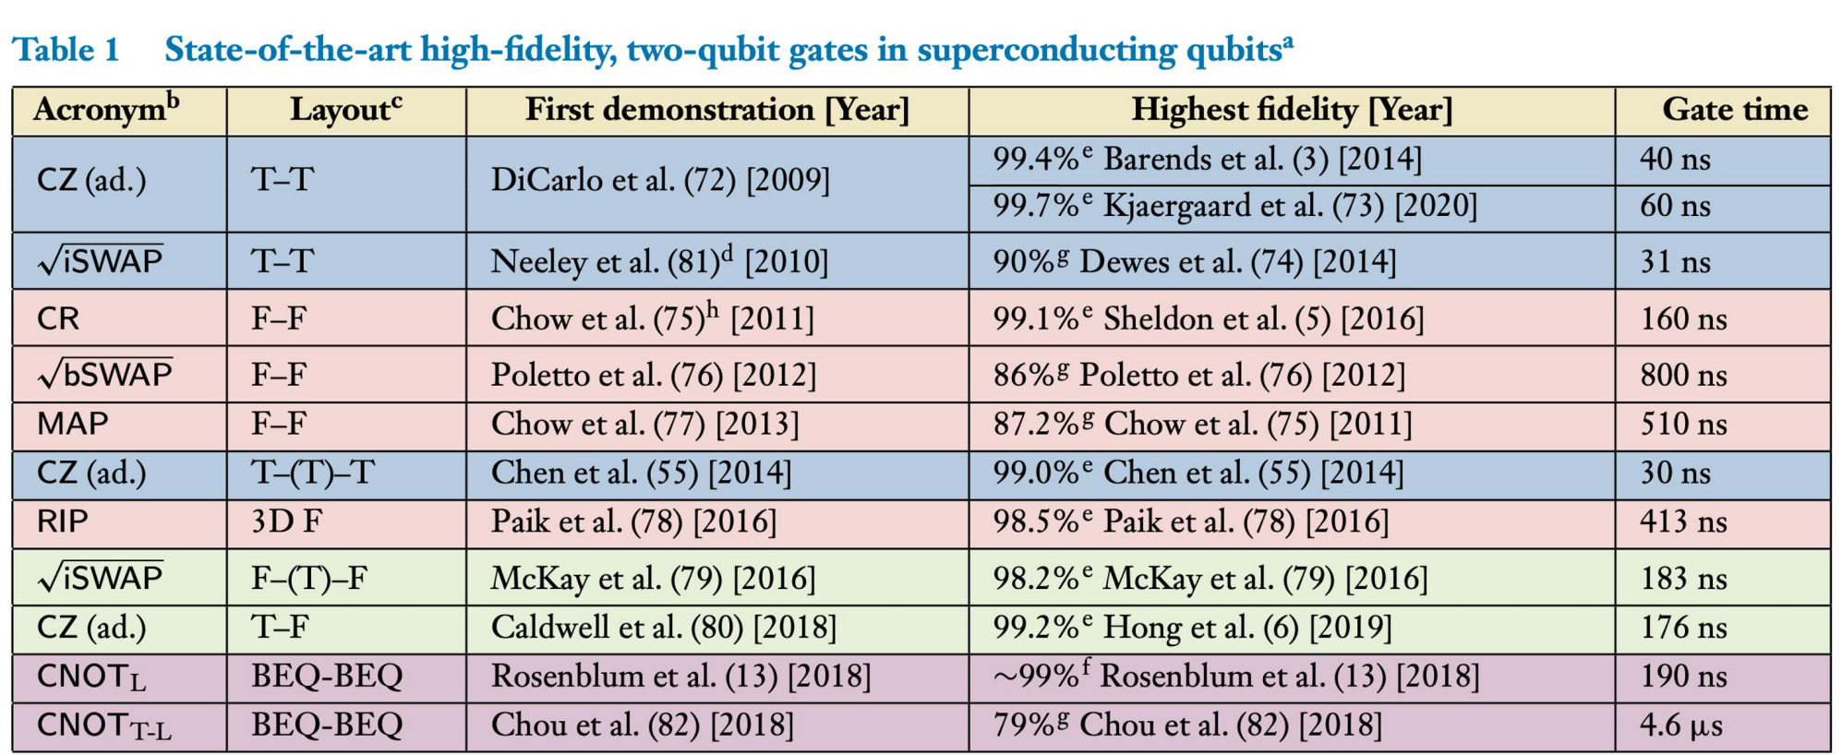
The Development of Quantum Hardware: Superconducting Technology

Slide 15
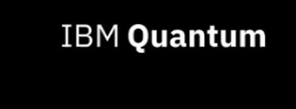
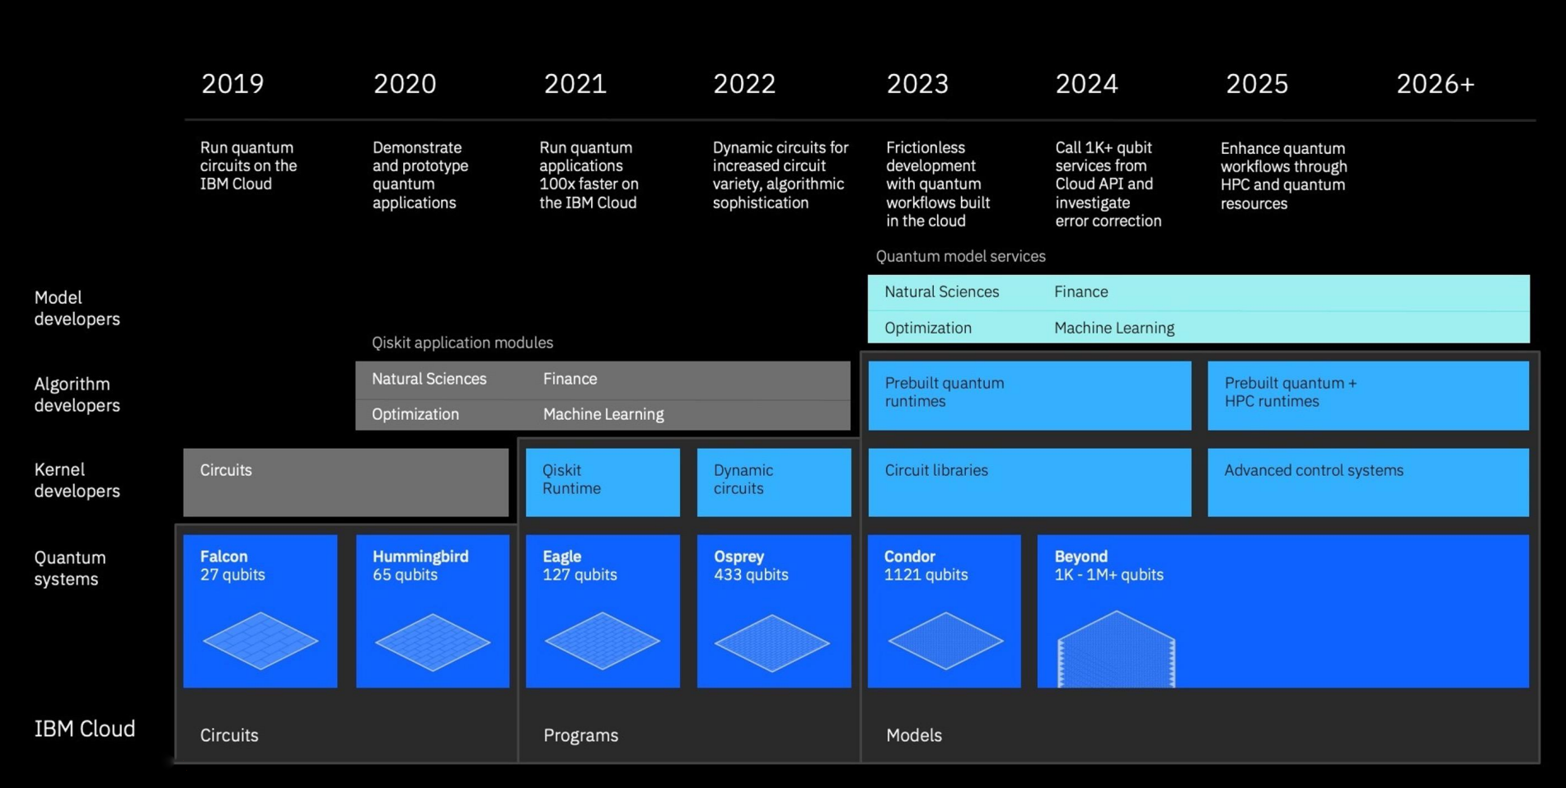
Development Roadmap

Slide 16
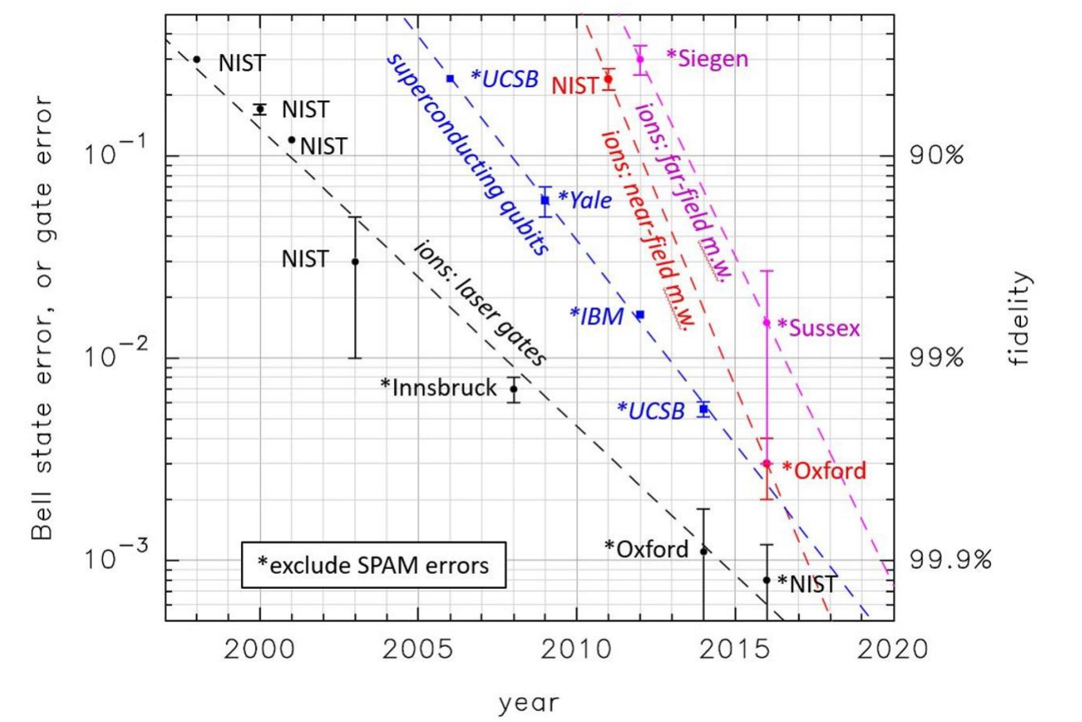
The Development of Quantum Hardware: Ion Trap Technology

Slide 17
The Development of Quantum Hardware: Ion Trap Technology

Slide 18
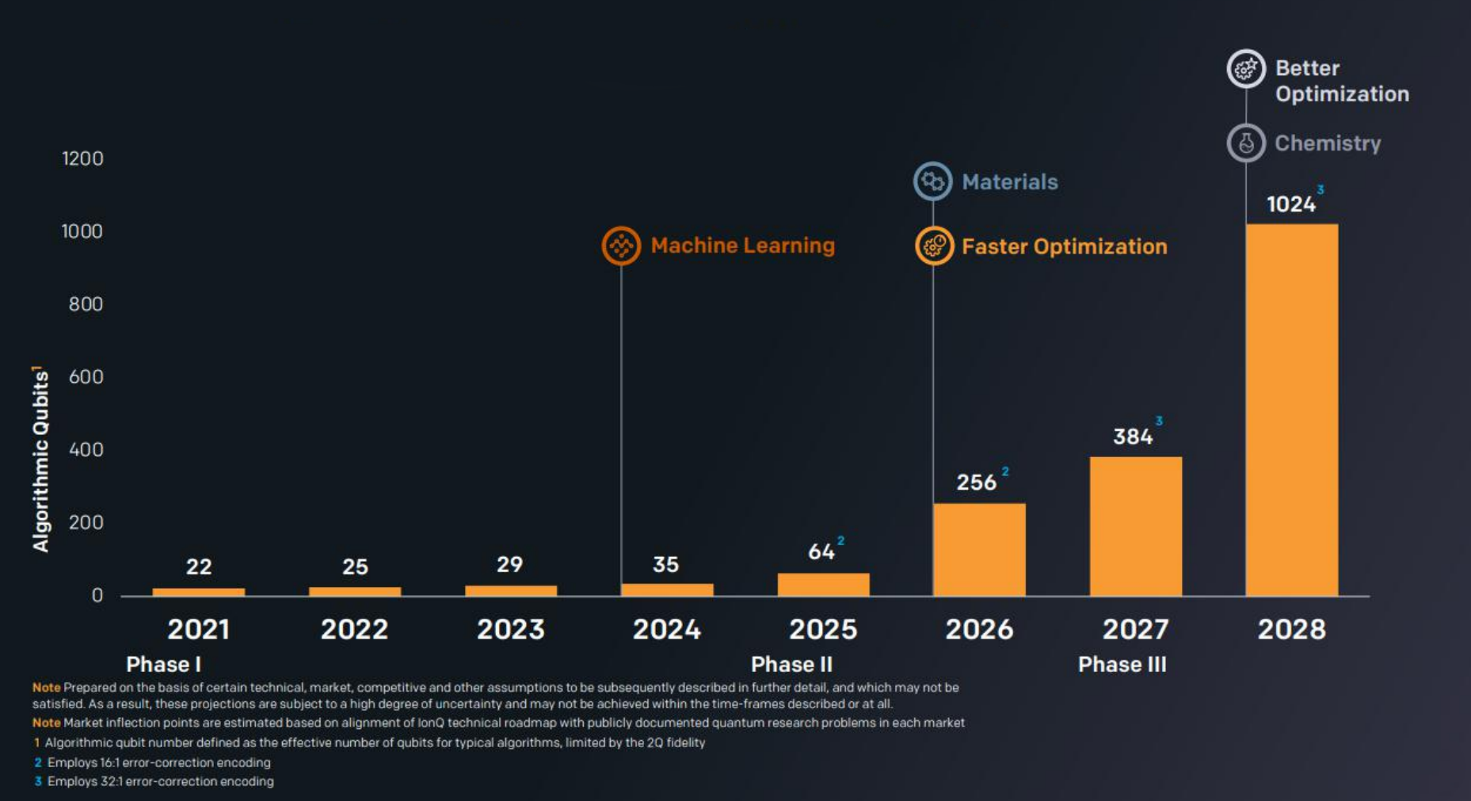
Roadmap For Growth & Market Leadership

Slide 19
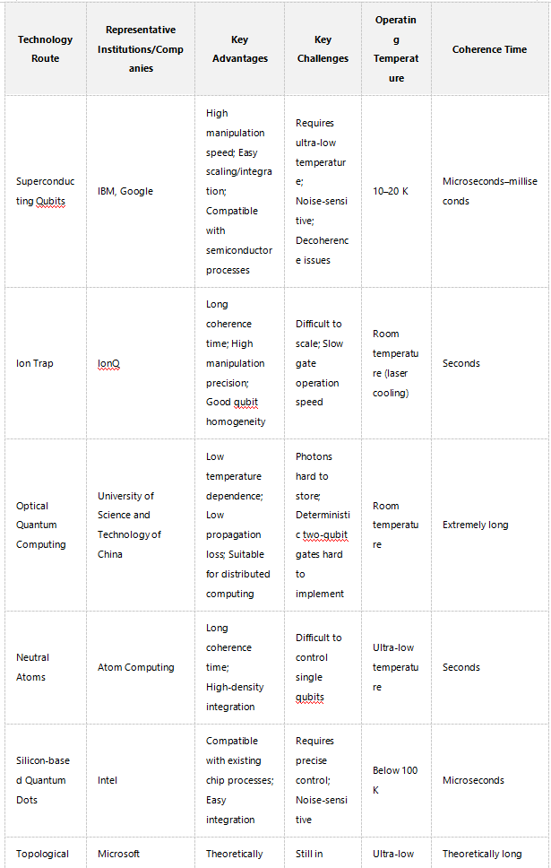

Comparison of Quantum Computing Technologies.

Slide 20
03
Integration of Quantum Computing and Intelligent Computing

Slide 21

Quantum Machine Learning
01
Quantum Algorithms for Machine Learning
Quantum machine learning aims to enhance traditional algorithms using quantum principles. Algorithms like QSVM and QPCA offer potential speedup by exploiting quantum parallelism and entanglement.
02
Quantum Neural Networks
Quantum neural networks combine quantum computing and neural networks, using qubits as neurons and quantum gates for operations. They have the potential to solve complex problems more efficiently than classical neural networks.
Quantum Data Encoding and Processing
03
Efficient data encoding and processing are crucial for quantum machine learning. Methods like amplitude encoding and quantum feature maps enable the extraction of meaningful patterns from quantum-encoded data.

Slide 22
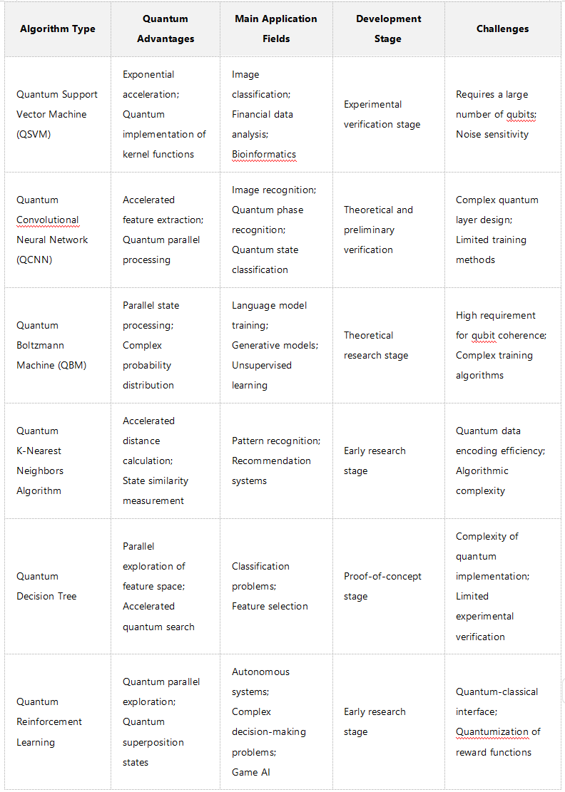
Comparison of Quantum Machine Learning Algorithms

Slide 23
Quantum Optimization for Intelligent Computing
01
02
03
Quantum Annealing and Optimization Problems
Variational Quantum Eigensolver (VQE) and Its Applications
Quantum Approximate Optimization Algorithm (QAOA)
Quantum annealing uses quantum tunneling to solve optimization problems more efficiently than classical methods. It is particularly effective for combinatorial problems like the traveling salesman problem.
VQE is a hybrid quantum-classical algorithm used for optimization and quantum chemistry. It combines quantum state preparation with classical optimization to find eigenvalues and eigenvectors more efficiently.
QAOA is a hybrid algorithm for solving combinatorial optimization problems. It balances quantum and classical resources to find approximate solutions more efficiently than classical methods alone.

Slide 24
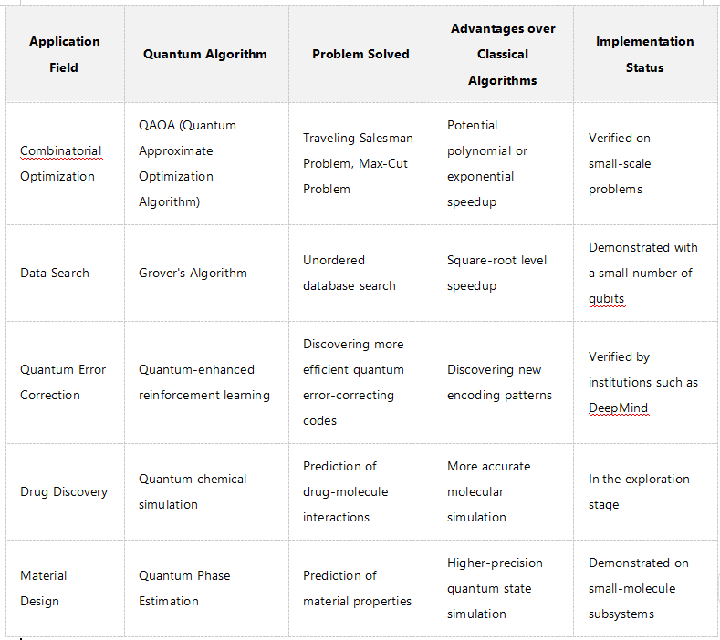
Application Cases of Quantum Optimization Algorithms

Slide 25
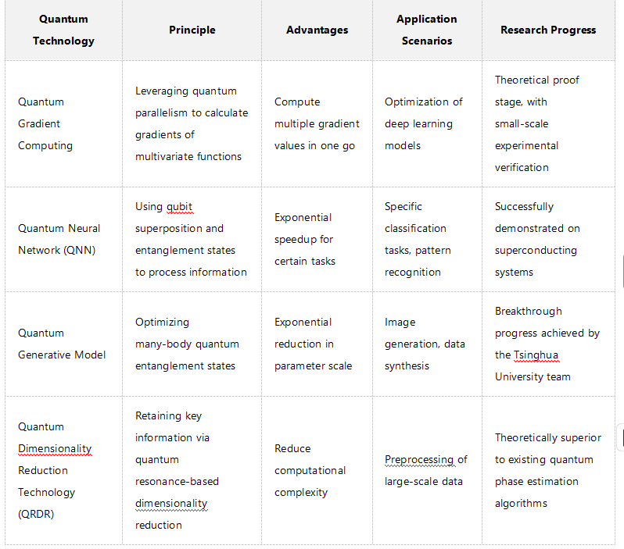
Comparison of Quantum Computing Technologies for Accelerating AI Training

Slide 26



Quantum Communication and Intelligent Systems
Quantum Key Distribution (QKD) and Secure Communication
Quantum Internet and Future Intelligent Networks
Quantum Teleportation and Distributed Intelligent Systems
QKD enables secure communication by generating shared secret keys using quantum principles. It ensures data privacy and security in intelligent systems.
Quantum teleportation allows the transfer of quantum states without physical transmission. It can enhance distributed intelligent systems by enabling collaborative computations and knowledge sharing.
The quantum internet envisions a global network of quantum devices for secure communication and distributed computing. It holds promise for revolutionizing intelligent systems in the future.

Slide 27
04
Case Studies and Applications

Slide 28
Quantum Computing in Drug Discovery
01
02
03
Quantum Algorithms for Molecular Simulation
Quantum Machine Learning for Drug Screening
Case Study: Quantum Computing in Cancer Drug Development
Quantum algorithms like VQE can simulate molecular behavior more accurately than classical methods. This enables precise predictions of molecular properties, accelerating drug discovery.
Quantum machine learning can process large molecular datasets more efficiently, identifying potential drug candidates faster. This reduces the time and cost associated with drug development.
Quantum computing has been used to simulate cancer cell interactions and identify potential drug candidates. This has the potential to transform cancer therapy by offering more effective treatments.

Slide 29
Quantum Computing in Financial Risk Management
Quantum Algorithms for Portfolio Optimization
Case Study: Quantum Computing in Credit Risk Assessment
Quantum Machine Learning for Fraud Detection
Quantum algorithms like QAOA can optimize investment portfolios more efficiently, considering multiple factors to maximize returns while minimizing risks.
Quantum machine learning can detect subtle patterns in financial transactions, improving fraud detection accuracy and reducing losses.
Quantum computing has been used to improve credit risk assessment models, providing more accurate predictions of borrower default likelihood.

Slide 30
Quantum Computing in Intelligent Transportation Systems
Quantum Optimization for Traffic Flow Management
Quantum algorithms can optimize traffic routing more efficiently, reducing congestion and improving overall traffic efficiency.
Quantum Machine Learning for Predictive Maintenance
Quantum machine learning can analyze vehicle performance data to predict equipment failures, enabling proactive maintenance and reducing downtime.
Case Study: Quantum Computing in Autonomous Vehicle Routing
Quantum computing has been used to optimize autonomous vehicle routing, improving travel time and overall transportation efficiency.

Slide 31
YOUR LOGO
05
Challenges and Future Directions

Slide 32

Technical Challenges in Quantum-Intelligent Integration
Error Correction and Fault Tolerance
Developing error correction codes and fault-tolerant architectures is essential for reliable quantum computations. This is crucial for quantum machine learning and optimization algorithms.
Scalability of Quantum Systems
Integration with Classical Systems
Scaling up quantum systems to handle larger problems is a significant challenge. Researchers are exploring modular architectures and error correction techniques to improve scalability.
Integrating quantum and classical systems requires efficient data transfer and hybrid computation frameworks. This ensures compatibility between quantum and classical algorithms.

Slide 33
Limitations and Challenges of Quantum Computing Hardware and Software
Hardware Limitations
1.Quantity and quality of qubits: Building qubits with sufficient quantity and high quality (low error rate, long coherence time) remains a huge challenge. The number of qubits in current quantum computers is far from the scale required to solve practical complex problems.
2.Coherence: The coherence time of qubits is still relatively short, limiting the complexity and runtime of quantum algorithms.
3.Scalability: How to effectively scale up quantum computers, increase the number of qubits while maintaining their performance, remains a technical challenge.
4.Operational precision and fidelity: Improving the operational precision and fidelity of quantum gates and reducing error rates are key to achieving reliable quantum computing.
5.Low-temperature and environmental control: Some qubit technologies (e.g., superconducting qubits) require operation in extremely low-temperature environments close to absolute zero, increasing cost and complexity.

Slide 34
Limitations and Challenges of Quantum Computing Hardware and Software
Software Limitations
1.Development of quantum algorithms: Designing efficient quantum algorithms for specific AI tasks remains a challenge.
2.Quantum programming and development tools: The programming models of quantum computing differ significantly from classical computing, and there is a lack of mature, user-friendly development tools and programming languages.
3.Capabilities of quantum simulators: Given the limited availability of real quantum hardware, high-performance quantum simulators are crucial for algorithm development and verification. However, simulating large-scale quantum systems remains extremely difficult.

Slide 35
Limitations and Challenges of Quantum Computing Hardware and Software
Potential Solutions and Technical Breakthrough Directions
1.Quantum error correction: Developing effective quantum error-correcting codes and fault-tolerant computing techniques is key to building large-scale reliable quantum computers.
2.New qubit technologies: Exploring and developing new qubit technologies that are more stable, easier to control, and scalable.
3.Hybrid quantum-classical computing: Combining the advantages of classical and quantum computers to accelerate computationally intensive parts of classical algorithms using quantum computing.
4.Construction of the quantum software ecosystem: Developing more advanced quantum programming languages, compilers, algorithm libraries, and application toolkits to lower the entry barrier for quantum computing.

Slide 36
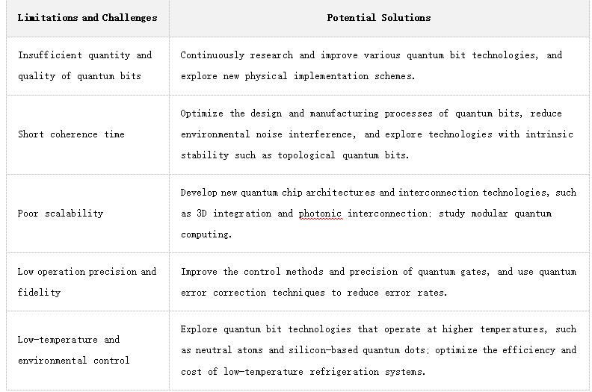
Limitations and Challenges of Quantum Computing Hardware and Software

Slide 37
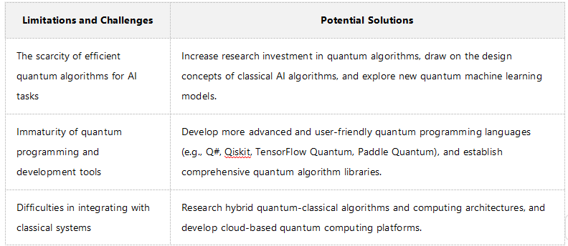
Limitations and Challenges of Quantum Computing Hardware and Software

Slide 38
Ethical and Societal Implications
01
02
03
Privacy and Security Concerns
Bias and Fairness in Quantum Machine Learning
Impact on Employment and Society
Quantum computing poses a threat to classical cryptography. Developing quantum-resistant cryptographic methods is essential to protect data privacy and security.
Quantum machine learning algorithms can inherit biases from training data. Developing methods to detect and mitigate bias is crucial for fairness and reliability.
The adoption of quantum and intelligent computing technologies can lead to job displacement. Strategies for retraining and upskilling workers are essential to mitigate negative impacts.

Slide 39
Future Prospects and Opportunities
Advancements in Quantum Hardware
Ongoing advancements in quantum hardware, such as improved coherence times and gate fidelities, will enable more practical applications of quantum computing.
Development of Hybrid Quantum-Classical Systems
Hybrid systems combining quantum and classical computing will drive innovation in intelligent computing by leveraging the strengths of both technologies.
Global Collaboration and Standardization
Global collaboration and standardization efforts are crucial for the development and deployment of quantum and intelligent computing technologies. This will ensure compatibility and security across different systems.

Slide 40
06
Conclusion

Slide 41
Summary of Key Points
Recap of Quantum and Intelligent Computing Integration
Importance of Addressing Challenges
Future Opportunities and Collaborations
The integration of quantum computing and intelligent computing offers significant benefits, including exponential speedup and advanced algorithms. This has the potential to revolutionize various fields.
Addressing technical challenges like error correction, scalability, and integration is crucial for realizing the full potential of quantum computing. Ethical and societal implications must also be considered.
Advancements in quantum hardware, the development of hybrid systems, and global collaboration efforts will drive innovation and adoption of these technologies.

Slide 42
Future Work and Final Thoughts
Ongoing Research and Development
Continued research and development in quantum and intelligent computing integration will be essential for overcoming challenges and unlocking new opportunities.
Encouraging Collaboration and Innovation
Encouraging collaboration between academia, industry, and government will accelerate the development of these technologies. Supporting startups will drive new ideas and solutions.
Final Thoughts on the Integration Journey
The integration of quantum computing and intelligent computing is both exciting and challenging. By addressing challenges and fostering collaboration, we can create a more efficient and intelligent future.

Slide 43
THANK YOU

